Slide 1
The FT Web App and Automated Testing
http://tinyurl.com/ft-app-testing
Jim Cresswell (jim.cresswell@ft.com, @JimCresswell) Developer, FT Labs (@ftlabs)
Feb 2014
Notes:
Hi, I’m Jim Cresswell, I’m a software engineer working at FT Labs, the web research and development group of the Financial Times.
I’m currently focusing on quality assurance and test automation which is what I will talk about today.

Slide 2
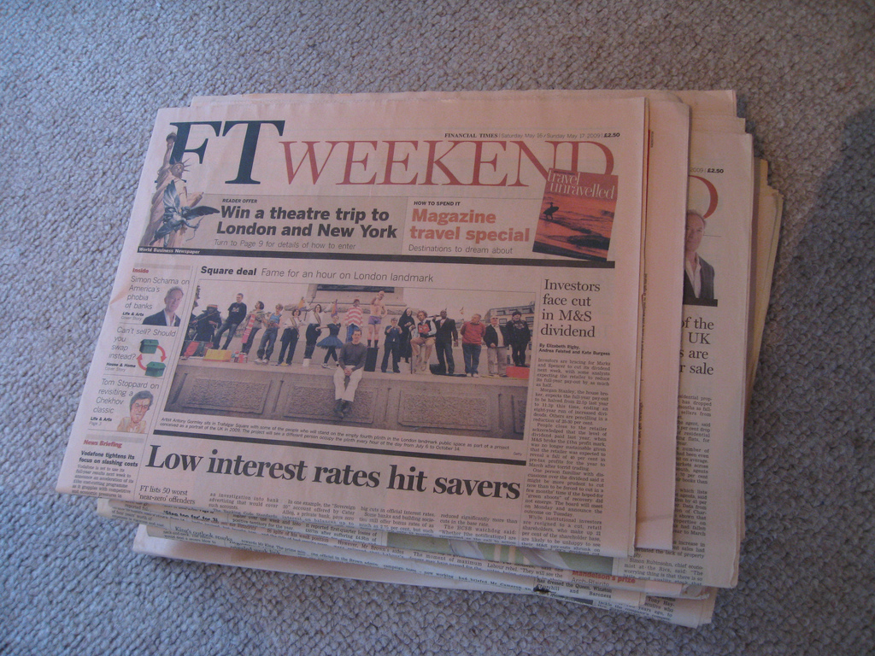
Notes:
The Financial Times is a newspaper. But it’s also a collection of edited and curated content available across a variety of media many of which are digital.
In total is has an average daily global audience of more than two million people. The majority of the FT’s subscribers consume their content in digital form.

Slide 3

Welcome back to the web
The FT web app provides a touch optimised user experience.
Notes:
The primary means of digital consumption are ft.com and the FT’s web app.
Here is a shot of how the web app used to look.

Slide 4
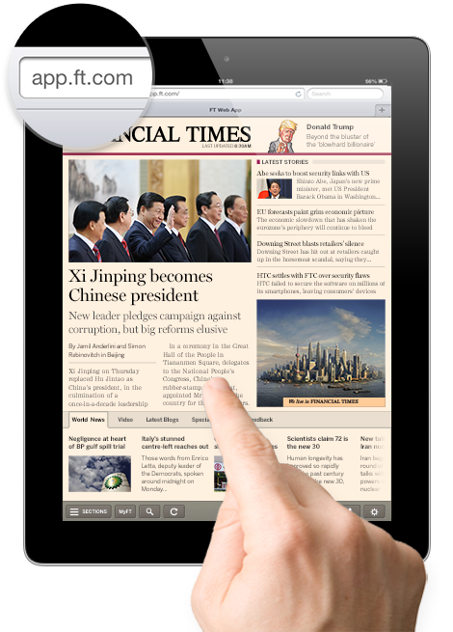
Notes:
It now looks more like this including, as of last week, the Android app which was the last platform to receive the new design.
What is a web app? It’s an app that is built with web technologies, or it’s a web page which supports behaviours people expect from an app. It works offline and all the HTML is generated on the client device rather than on the server. If anyone wants to discuss that more let’s leave that until after the talk.

Slide 5
app.ft.com – same code everywhere.
Notes:
Why a web app? The web app code is cross-platform, all the versions of the app on all the platforms on all the screen sizes use the same code. On some platforms we wrap the app in some other code to allow access to platform specific features.

Slide 6
app.ft.com – same code everywhere
Main platforms
iOS - iPhone and iPad – fullscreen web app
Android – Java wrapper
Windows 8 – HTML5 wrapper
Beta platforms
Most modern mobile and desktop browsers
Notes:
Our main platforms are iOS, Android and Windows 8.
For the Android app we have a Java wrapper containing a WebView, giving access to features like native sharing. For the Window app we have a similar arrangement but the wrapper code is also written in using HTML, JavaScript and CSS.
On iOS installation is through broswer. The Android and Windows apps are installed through app stores. If you type app.ft.com into a modern browser there is a good chance it will work.
The cross-platform nature of the web does not solve every problem, but it has been an excellent choice for the FT.

Slide 7
FT Labs labs.ft.com github.com/ftlabs @ftlabs
Notes:
The web app is developed by FT Labs (once upon a time known as Assanka). For those interested here is our URL, our Github page with our open source software and our Twitter handle.
At some point I will put these slides on the internet so you will be able to find these links again.

Slide 8
FT digital numbers
The FT app has over 4 million users (subscribers and anonymous).
“[Digital] subscribers are increasing 24% year on year to almost 387,000.”
“Mobile devices now generate 60% of [digital] subscriber consumption, 40% of total traffic and a quarter of new digital subscriptions.”
Notes:
There is free content on ft.com and in the app but the majority of FT content is behind a pay-wall.
The app has over 4 million users.
Digital subscribers have increased 24% year on year to almost 387,000.
Mobile devices generate 60% of subscriber consumption, 40% of total traffic and a quarter of new subscriptions.
The FT focuses on digital first, and digital content consumption is being driven by mobile.

Slide 9
FT app architecture
Offline capable Javascript/HTML/CSS front end, which talks to…
Largely PHP backend, which talks to…
FT content infrastructure.
Git, Github Enterprise, Jenkins.
Notes:
In brief, the app architecture is a HTML, JavaScript and CSS frontend and a PHP backend.
To give you some idea of scale we have over eleven hundred (1100) files in the front end architecture; this is a software engineering project with software engineering problems to solve.
For version control we use Git and Github Enterprise which is the “host it yourselves” version of Github, and we use software called Jenkins for continuous integration – if you aren’t familiar with continuous integration it largely means building and testing your project when changes are made to the code or other project related resources.

Slide 10
How do we stop it from breaking? Testing What sort of testing?
Notes:
How do we stop this complex product from breaking? Lots of testing.
I’m mostly talking about testing that the product interface and back end behave as expected, rather than say network testing or stress testing or security testing. So I’m talking about unit tests, integration tests and functional tests. Where unit testing is testing the interface to a unit of code, integration testing is testing the integration of two or more of those units working together, and functional testing is testing a large stack of units, frequently the whole system and often testing via products user interface.
A lot of our tests are automated, and I do think that automated testing is very important, but I will say now that I think manual testing is critical if you don’t want to deliver broken or frustrating products to your customers. So how much of what type of testing should we do? A very broad answer is “take a look at the software testing pyramid”…

Slide 11
Test Pyramid
Manual
Testing
Functional (GUI) Testing
Integration Testing
Unit Testing
Notes:
This is the software testing pyramid, there are plenty of version of this diagram on the web.
The general idea is that test types are organised by how costly they are to create and maintain. The most expensive tests are at the top and the cheapest at the bottom. The pyramid shape is intended to suggest that you should do more of the faster and cheaper automated tests at the bottom of the pyramid, and less of the slow and expensive tests at the top. However…

Slide 12
What happens when you retrofit automated testing to a project?
Notes:
What happens when you retrofit automated testing to an existing project?

Slide 13
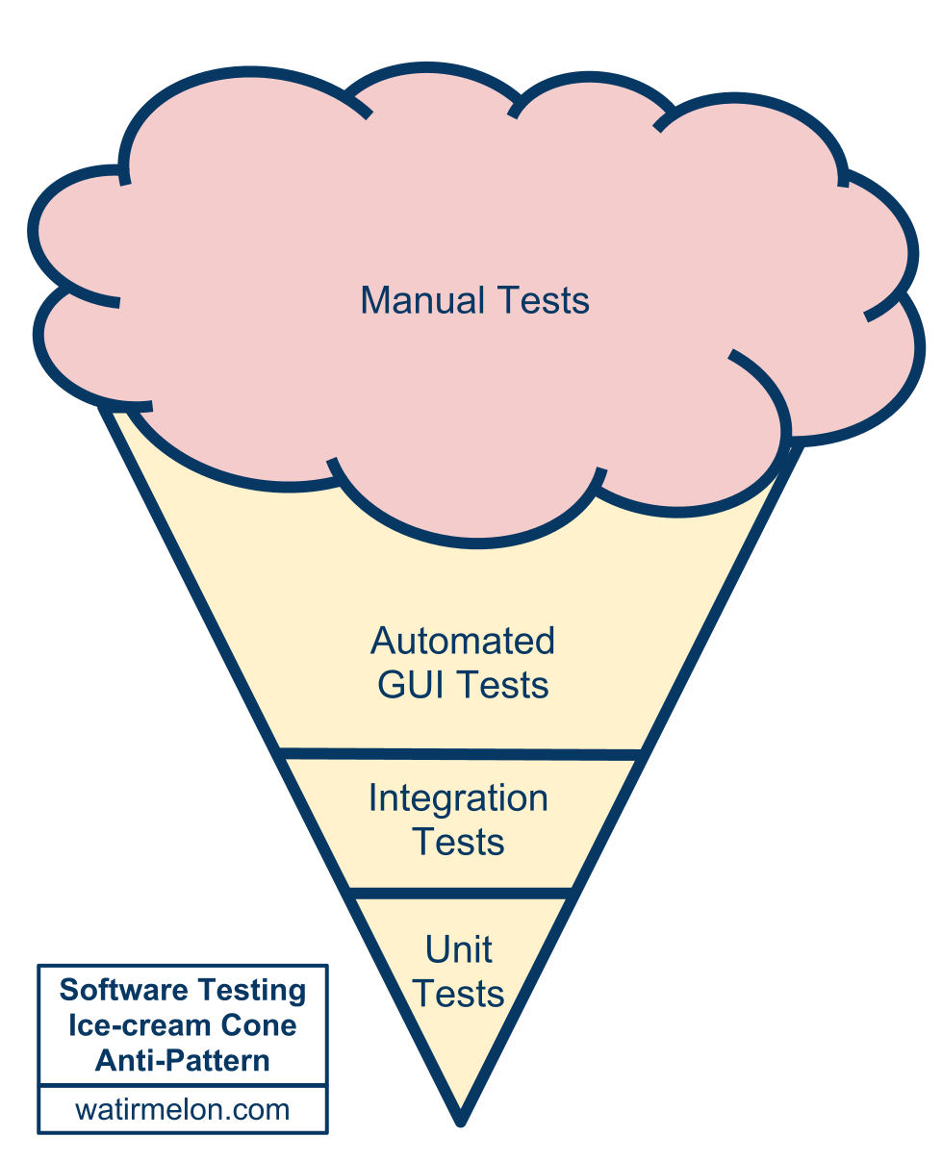
Test Ice-cream
Source:
Alister Scott
http://tiny.cc/testing-pyramid
Notes:
The testing ice-cream!
Lots of manual testing, with some manual test that have been automated. With maybe few automated code tests thrown in by the enthusiastic, and perhaps even some unit tests. Credit to Alister Scott for either coming up with or writing about the ice-cream.
This arrangement is somewhat costly to maintain, somewhat slow to run, but it is a lot better than no automated tests at all. So if you have reached this point you have done good work. It’s nothing to be embarrassed about. You may want to go further towards the pyramid.

Slide 14
What is the point of automated testing?
Notes:
At this point I would like to mention that for the FT app we have two testing groups, the first one is in-house at Labs, and the second one is at the main FT office. The second team are effectively a user acceptance testing group who also run manual and automated testing. These two groups have different priorities, on the Labs side I think that there are broadly four things we are trying to do with testing.

Slide 15
What is the point of automated testing?
To speed up and aid in code design and refactoring.
To give fast feedback to developers – let them focus on innovation.
Making sure the product isn’t broken.
Allow manual testers to do what only a human can do.
Notes:
To aid code design, that’s what unit tests are for. I think this should largely be left up to developers as it is essentially a choice of implementation methodology, with support from the test team where necessary.
To give fast developer feedback. This is currently the focus of my work, I want developers to know when an issue has arisen as early in the development process as possible because that enables them to fix it with the least effort and in the least time. Fast feedback allows developers to focus on innovation rather than stopping what they are doing to fix a problem in another part of the code that they were working on a week ago.
To provide regression testing. The testing we do a Labs, both manual and automated certainly helps here, but this is more the focus of the UAT team.
And manual testers should be given the kind of exploratory, intuitive, feeling based testing that only a human can do, because if your product has an API or a user interface then it’s humans that you are building for and humans that you want to keep happy. That’s only possible if you have automated the repetitive and boring tests.

Slide 16
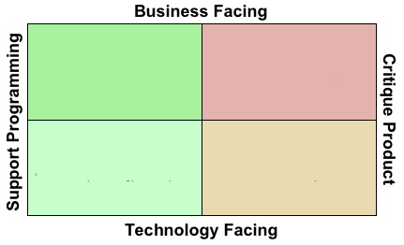
What is the point of automated testing?
Testing quadrants
Source: Brian Marick
http://www.exampler.com/old-blog/2003/08/21/#agile-testing-project-1
Notes:
Here is another expression of what testing can be for, including manual testing, called “the testing quadrants”. As far as I know the idea was first proposed by Brian Marick.
The diagram says that testing can support code design and refactoring, and it can support critiquing the product. It can also test business requirements, and technology or code requirements. What we’ve done at Labs over the last 6 months has at least touched all those quadrants but with a focus on supporting programming.
There is a talk entitled “test is dead” by Alberto Savoia, which I recommend and which I will link to later. In the talk he puts forward the opposing ideas of “testing you are building it right” and “testing you are building the right it”. I think that idea ties in nicely with the left and right sides of this diagram.
My point here is that it’s important to acknowledge that testing is for more than just proving that things work they way you expect them to.

Slide 17
Where were we 6 months ago?
Notes:
So where was FT Labs 6 months ago?

Slide 18
Where were we 6 months ago?
Lots of manual testing.
No automated functional tests.
Quite a few automated integration (unitish) tests.
Notes:
We relied heavily on manual testing. We certainly had some code tests but they pertained to the back end code and the data it provided rather than the operation of the product UI. We had no automated functional tests at Labs, there were some at the FT main office using a tool called Eggplant.
With this setup we created a great product, but as we expanded to more platforms and more features and faster development this was becoming limiting and we needed to be able to scale testing. We needed to automate.

Slide 19
Where are we today?
Notes:
So where are we today?

Slide 20
Where are we today?
Lots of manual testing – but finding many fewer issues and less serious issues.
Lots of automated functional tests.
Lots of automated integration (unitish) tests including…
JavaScript tests of required-in modules – see http://github.com/ftlabs
Notes:
We still have lots of manual testing – but we are finding fewer and less serious issues, there is more time for exploratory testing and finding weird edge cases or asking questions like “how does the app feel?” – feeling is important, if the app feels sluggish or annoying in some ill defined way then users will put it down.
On the web app, at the Labs stage, we have one manual tester. Almost everything he does is exploratory, there is little reliance on formal test plans, and it's great, he finds the problems that are hard to write algorithmic tests for. If he finds something repetitive to do he either automates it or writes down steps that could be automated.
We have lots of automated functional tests, which I’ll come back to. We have still have code tests – We have more than before, features are generally not considered complete until they are well tested. The automated tests run frequently so developers get feedback fast.
It’s worth mentioning that a lot of our JavaScript is tested by pulling it out into separate, easily testable modules which we can then include in multiple projects, you can see examples on our Github page.

Slide 21
Automated functional testing
Notes:
Lots of the effort over the last 6 months has focused on creating a suite of automated functional tests to test the web app via it’s UI. The initial push here was automating as much of our manual regression test plan as we could. We probably automated around 80-90% of the regression plan, and with simple parallel test execution can run through it approximately 30 times faster than a manual tester.

Slide 22
Automated functional testing
We use Webdriver http://docs.seleniumhq.org/projects/webdriver/
Tests run in browsers, most of the problems we used to catch manually were cross-platform.
Tests are written in Java but could have been written in most languages.
Notes:
The functional tests use a tool called Webdriver, also known as Selenium 2. Webdriver is a set of set of commands for manipulating the browser, a protocol for communicating those commands to the browser and an API within the browser to execute those commands, commands like “click on this element” or “type this into the selected input box”.
We test in the browser, partially because most of the problems we find are cross-platform, and partially because testing a web app or hybrid app on a device is hard. On device testing is certainly something we will be looking into. The tests are written in Java but could just as easily have been written in JavaScript or Ruby or Python or Perl. Java was chosen because that implementation tends to get new features first.
The functional test suite takes about twelve minutes to run including deployment of the app to a webserver. We currently run 8 tests in parallel on a physical computer. We want to make this a lot more scalable by using Selenium Grid to run all the tests at once on many virtual machines, meaning that the time to feedback should never rise above about five minutes no matter how many tests we add.

Slide 23
Jenkins
Notes:
Earlier I mentioned that we use software called Jenkins for continuous integration.

Slide 24
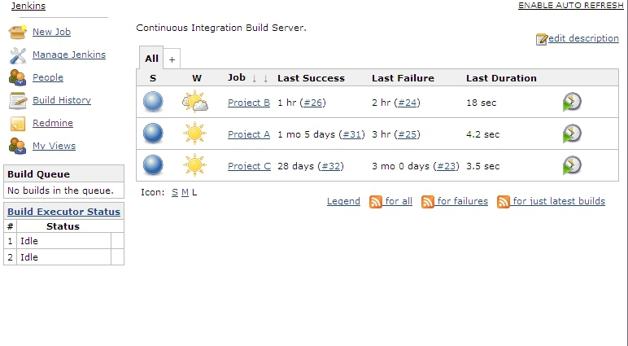
Builds passing
Notes:
When there is a change in the code Jenkins either notices or is informed and acts a the instigator of tests and the place where we can see the test result.
Here an example of the Jenkins main page, showing three projects, they are all blue which means that currently they are all passing their tests and healthy.

Slide 25
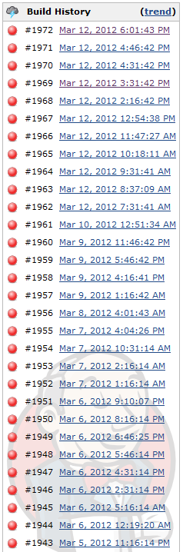
Builds failing
Notes:
Here is a list of builds for a single project where every build is red. Red means that Jenkins is not happy, and that everyone should pay attention, and someone should figure out what the problem is and fix it.

Slide 26
Pull requests and code reviews
Notes:
Tests are very important, but an equally important and very powerful mechanism for improving code and product quality are pull requests and code reviews. I’m going to talk about these here because they are related to one of the ways we do testing.

Slide 27
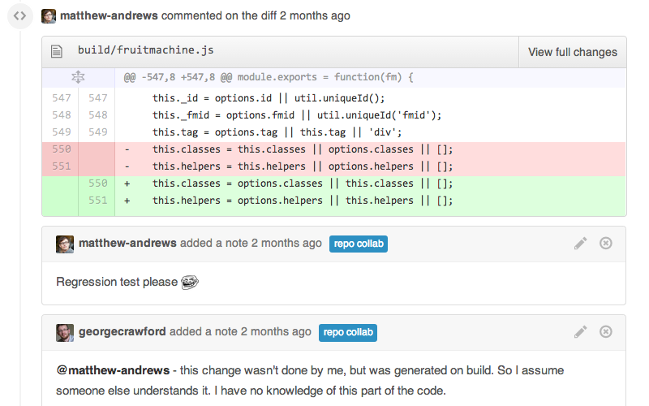
Pull requests and code reviews
Notes:
For anyone not aren’t familiar with pull requests, it is a request for the new code that a developer has been working on to be merged into the main version of the code. Pull requests are a feature of software management tools such as Github.
Here you can see two developers having a conversation about some proposed changes, with one of them suggesting adding a test.
Reviewing a pull request means that code always has multiple pairs of eyes on it before it is merged into the main code base. This has been a great tool for learning and teaching and improving quality.

Slide 28
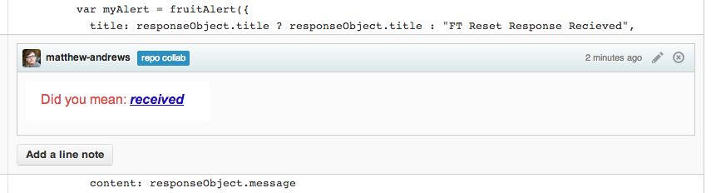
Pull requests and code reviews
Notes:
And here’s an example of a code review catching a fundamental issue.

Slide 29
When do we test?
Notes:
I think one of the most interesting questions is “when do we test?”. When do we have Jenkins run the automated tests?

Slide 30
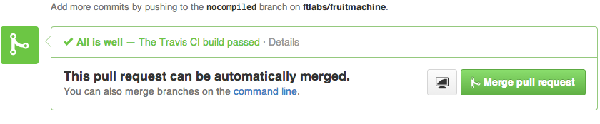
When do we test?
Before a commit is merged into the main branch.
When the main branch changes, and periodically outside working hours.
Hourly against the live product.
Notes:
Here’s the bit that is related to pull requests. We run the tests before a commit is merged into the main branch, just like for code reviews. The important difference is that we test the code that would result from the pull request being accepted. We never merge code that would result in a broken build – this prevents broken code from holding up others developers doing work, once the broken code is fixed and we know it won’t cause problems then we can merge it.
The image show the results of passing tests being reported back to the Github UI. These results aren't form Jenkins but from a similar system called Travis CI which we use for out open source projects, but any kind of feedback to Github from tests would look similar.
We also run tests whenever a change is merged to the main branch, and at least hourly. One reason to run tests when there hasn’t been a code change is to catch issues that might occur with infrastructure.
And, on the basis that there is no fundamental difference between testing and monitoring we also run the functional tests against the live version of the app.

Slide 31
Where do we want to go?
Notes:
What do we want to achieve in the next 6 to 12 months?

Slide 32
Where do we want to go?
Continuous delivery – releasing one feature at a time.
Parallel testing on many browsers – Selenium grid.
Parallel testing on many devices.
A set of super fast code tests that runs whenever a developer hits save.
Total regression coverage - never hear about a problem from an external source twice.
Notes:
We are considering moving towards continuous delivery, releasing one feature at a time when that feature is ready.
We want to use Selenium Grid to add scalable parallelism to our tests with the aim of minimising developer feedback time.
We are exploring the emerging tooling for testing web apps and hybrid apps on device, such as Appium, iOS-driver and Selendroid. I’ll give links to those at the end.
We want super fast feedback to developers when hitting save on the file they are editing, tools such a Grunt for JavaScript allow this.
We want zero tolerance on regressions, we never want to hear about the same problem from an external source twice.

Slide 33
Summary
Notes:
So, in summary…

Slide 34
Summary
Testing is good.
Automate what you can automate (without going nuts).
Pyramids are better than ice-cream. Ice-cream is better than nothing.
Manual testers should never be bored, give them the interesting stuff that a computer just can’t do. Let the computer do the rest.
Notes:
Testing is good. You probably knew that, but I think it helps to keep saying it.
Automation is also generally good. Consider the longer term repercussions of automation, is it going to save you time, this month, this year, is it going to mean you never break the same thing twice? Probably.
Don’t spend more time on expensive functional tests than you do on cheaper, faster code tests… unless you want to. Some automated testing is better than no automated testing.
Manual testers should never be bored, give them the interesting stuff that a computer just can’t do. Let the computer do the rest. People are way better than computers at deciding what will annoy other people. You will always need manual testing.
Has the effort we put into automation, of learning new tools, new languages, of creating the tests been worth it? Definitely. We find far fewer problems now, the problems we find are less serious, or more subtle, and we can focus on a level of quality that we couldn’t before. It’s been 6 months since we got a call from the UAT testers telling us that the app doesn’t load.

Slide 35
Reading and resources
Open source libraries http://github.com/ftlabs
Tutorials and articles http://labs.ft.com
On device GUI testing (web/hybrid/native) http://appium.io/ http://ios-driver.github.io/ios-driver/ http://selendroid.io/
“Test is dead” - Alberto Savoia http://www.youtube.com/watch?v=X1jWe5rOu3g
Notes:
Here are a few links you might find interesting. The FT Labs open source libraries are on Github. There are some tutorials and articles on the Labs website. And for anyone interested in testing web, hybrid and native apps with the same test suites here are some links to projects which are attempting to enable that. And as I said, I recommend this talk by Alberto Savoia entitled “Test is Dead”.

Slide 36
Thanks!
http://tinyurl.com/ft-app-testing
Jim Cresswell
jim.cresswell@ft.com, @JimCresswell
Sound like fun?
labs.ft.com/jobs
Notes:
Thanks for listening!
If anyone is curious as to what the functional tests look like in action then find me afterwards and I can give you a demo on my laptop.
And, if you are a test automation engineer looking for a job let me know.
http://tinyurl.com/ft-app-testing

